Slide 1
Tarmo Nakkurt
must maja OÜ
2021
Notes:
Pärnu 1. KK - keskharidus
Suuremõisa tehnikum – Haldusjuht – Clik / projektijuht, töökeskkonna ja TO spetsialist, kvaliteedijuht, haldusjuht ja juh.liige
TLÜ Haapsalu Kolledž – Tervisejuht – Skanska – TO spetsialist
must maja – koolitaja ja kirjastaja ning talunik

Slide 2
What is TOM?
TOM is short version from words “tööohutuse mõõdik” “safety metric”.
TOM is an easy-to-use and, when used correctly, indicative tool with reliable and comparable results, which both meets the legal requirements and allows the results of this inspection to be compared over time and major and / or recurring errors to be identified

Slide 3
What is TOM?
The occupational safety inspection methodology is based on the Finnish measurement methodology (TR-mittaus, 1992), which looks at the construction site in six different categories that reflects good practice and the legal safety requirements.
The best result on a construction site can be 100% (means no negative observations). A good result is from ~ 90%. Bad result is less than 82%.

Slide 4
What is assessed
during the inspection?
working habits and usage personal protective equipment
scaffolding and ladders (including walkways, etc.)
machines and devices
fences, openings, danger areas
electricity and lighting
procedures, waste management and dust

Slide 5
How is assessed
during the inspection?
What happens on the construction site is assessed on the basis of "right" and "wrong". Everything that can be seen must receive an (honest) assessment.
(explanation of the principle: if a red light is on at a, traffic light (trafikljus) it is a red light and not yellow or green. And the fact that green comes after red does not make it less red than red…)
Each observation is unique and will be noted

Slide 6
What the result shows?
Once the entire construction site has been completed and assessed, many assessments can be made (both "correct" and "incorrect”).
The result % shows the percentage of errors (negative findings)
_{TOM % =} correct ___ˇ
correct + incorrect ^{X 100}

Slide 7
Which can go wrong?
not all observations are noted
“false" is marked as "correct", thinking that it will be fixed immediately or very soon
the auditor does not know what is wrong, what is right
only part of the construction site is inspected
there is no work ongoing on the construction site

Slide 8
The methodology is the same, but usable environment is mobile and comfortable, the inspection visit is formatted correctly, the responsible person (s) is / are informed of the detected deficiencies quickly, the occupational safety situation on the construction site is easy to monitor, saves time (time = money).

Slide 9
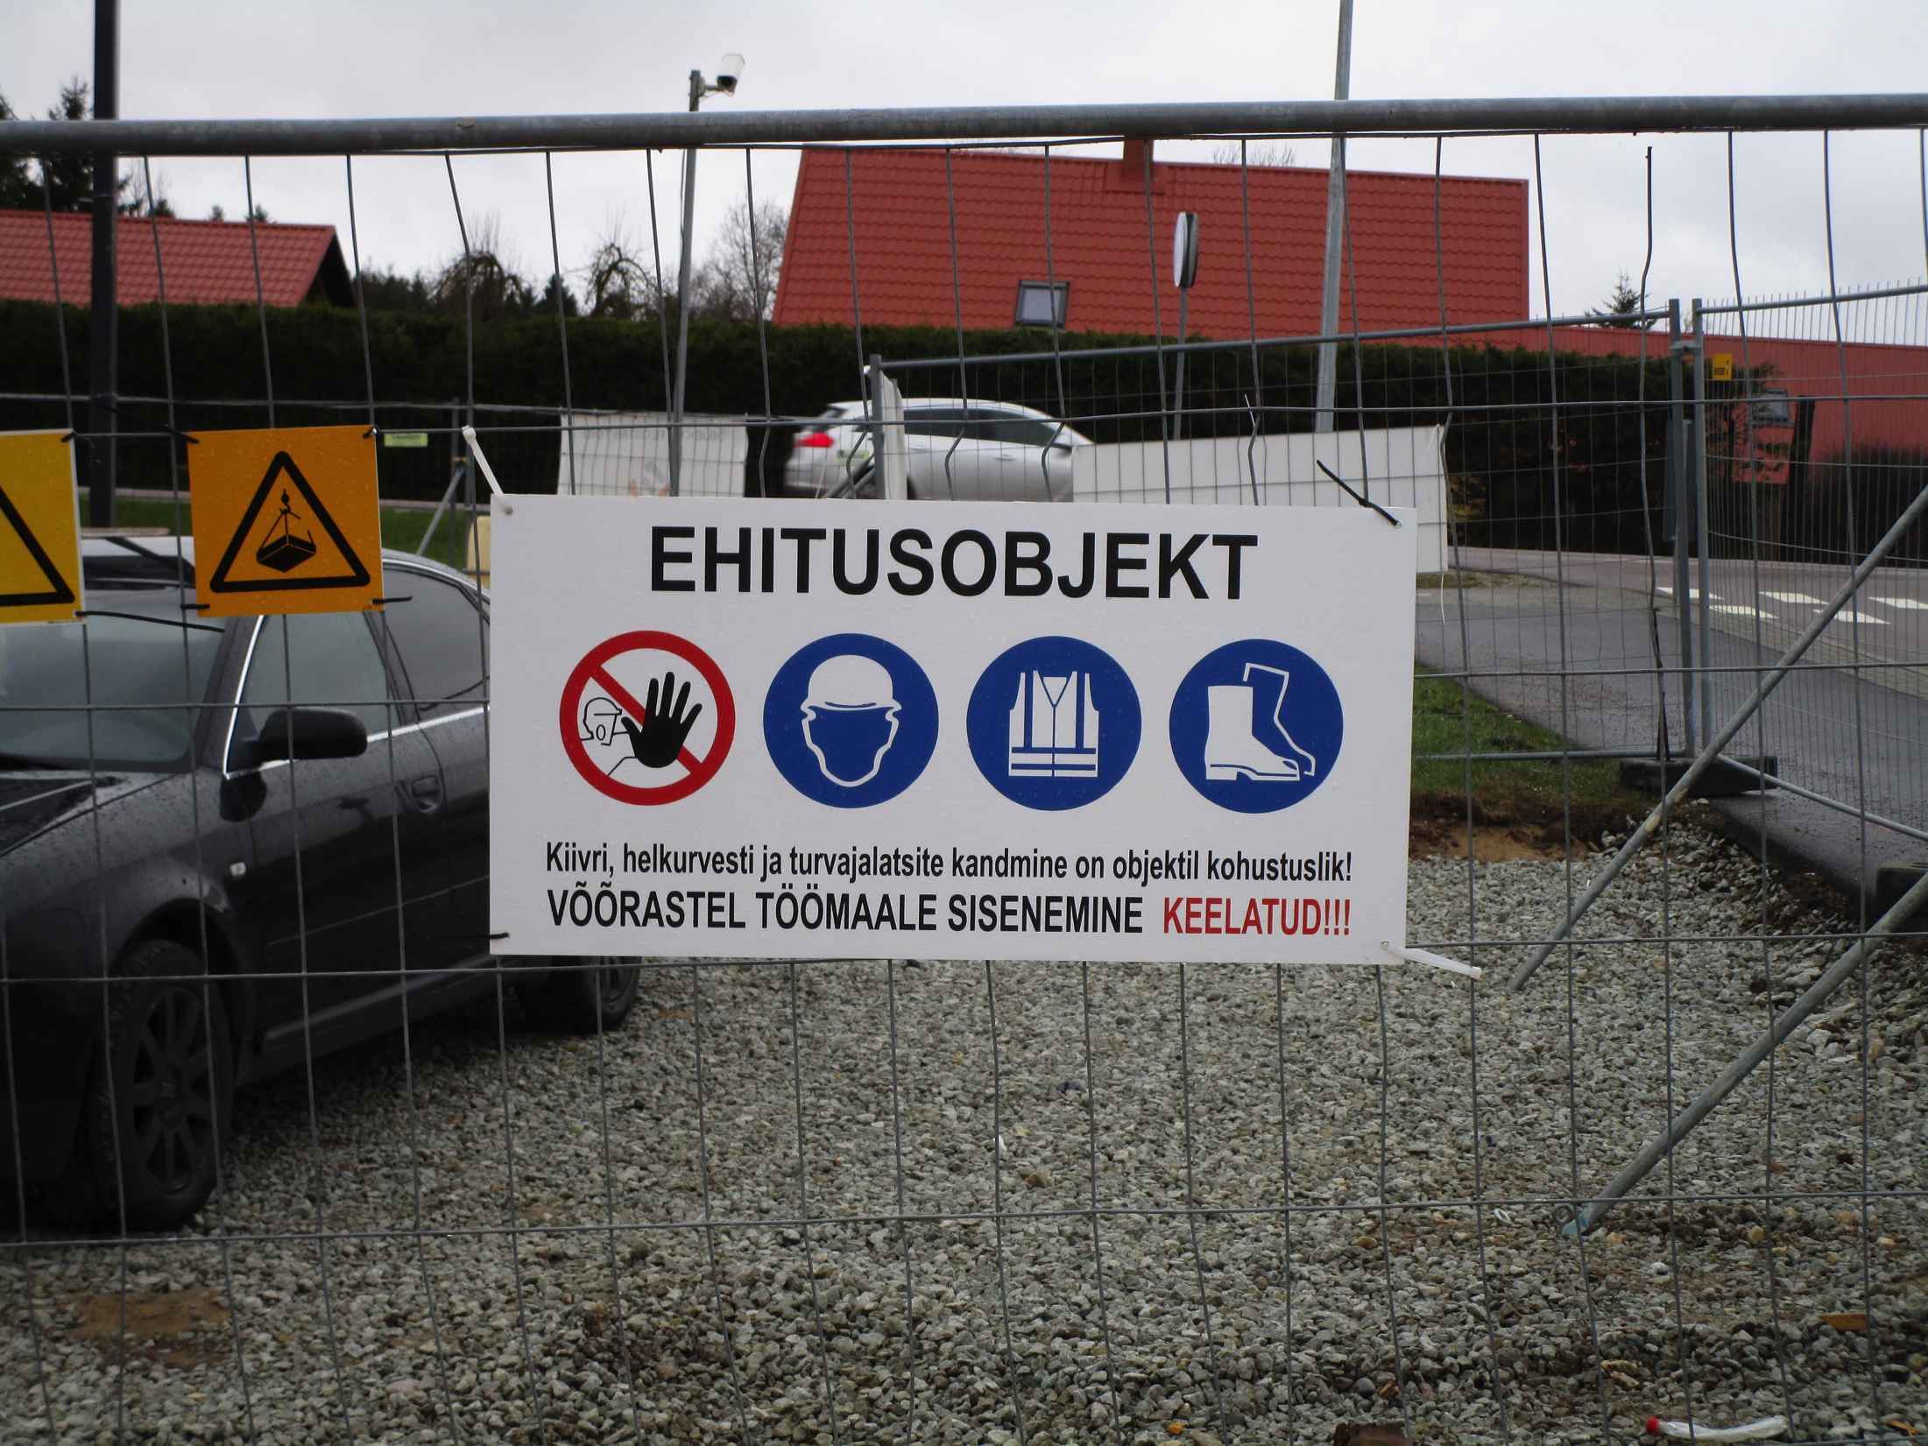
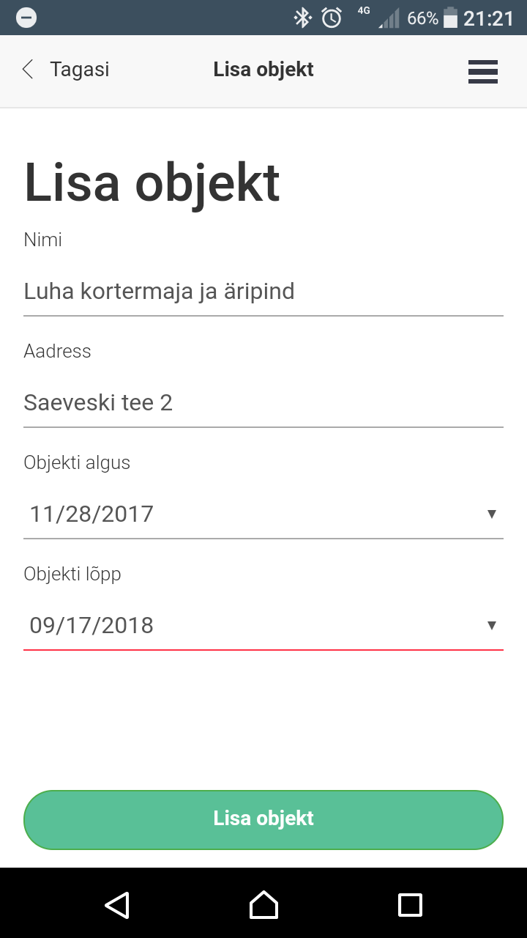
You go to the construction site, open the application…

Slide 10
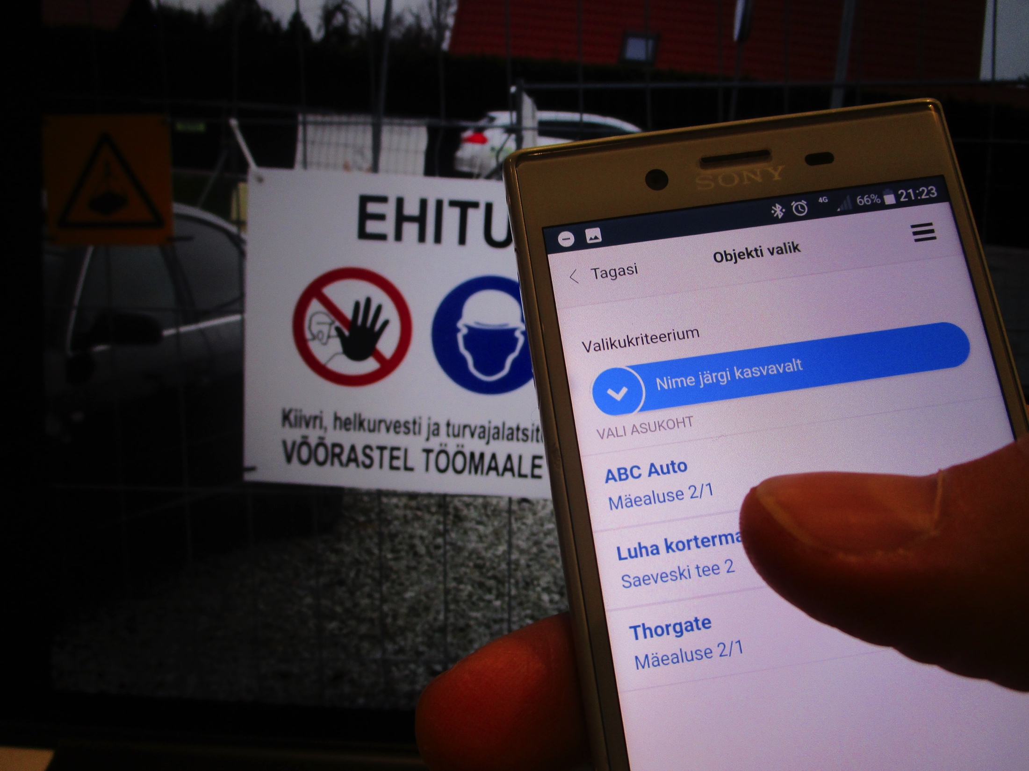
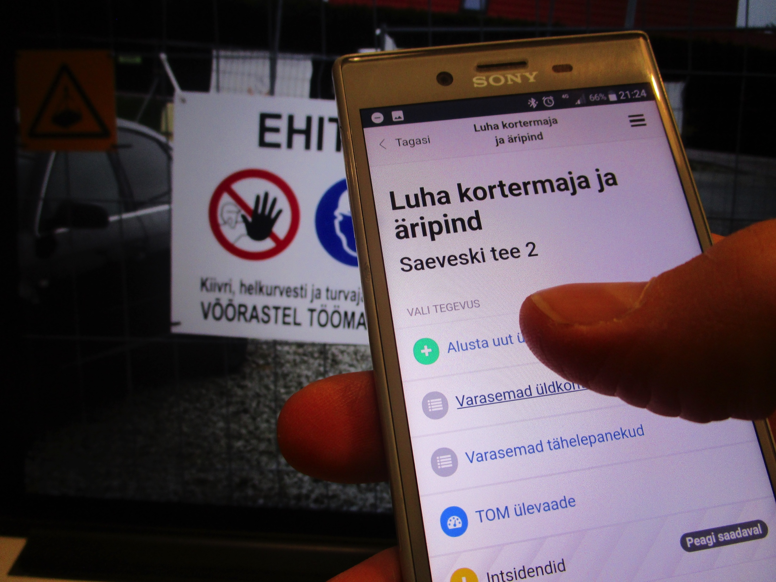
select the site from the list and start the general check

Slide 11
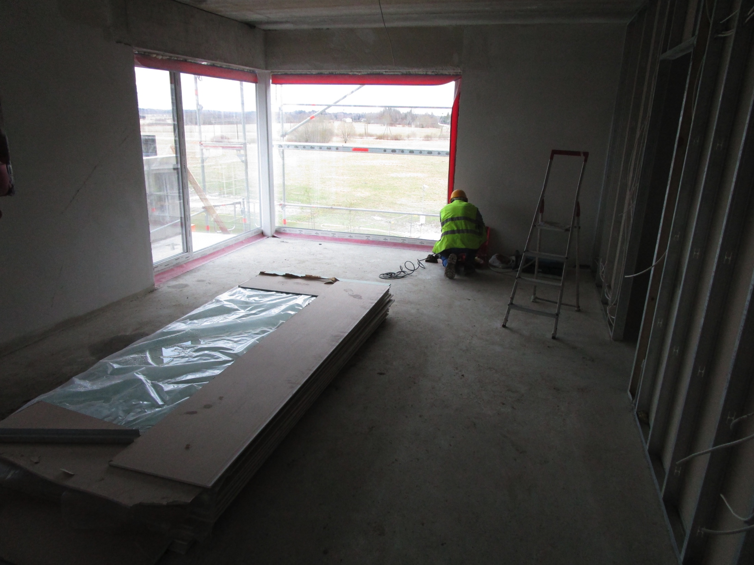
assess the occupational safety situation by different categories

Slide 12
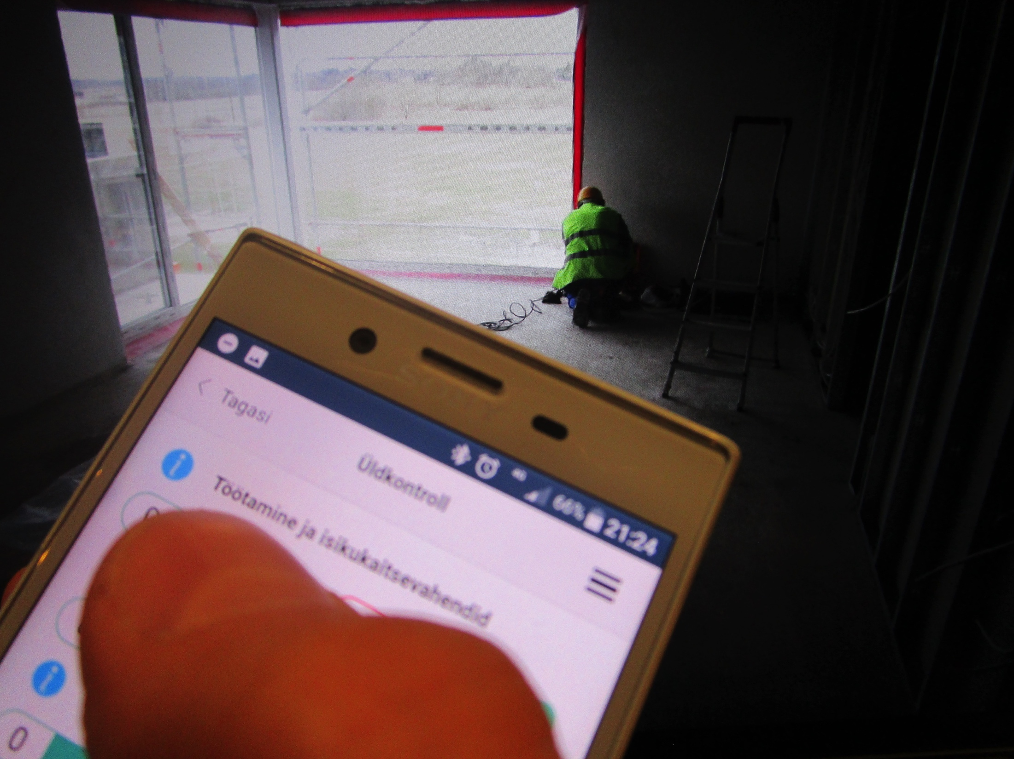
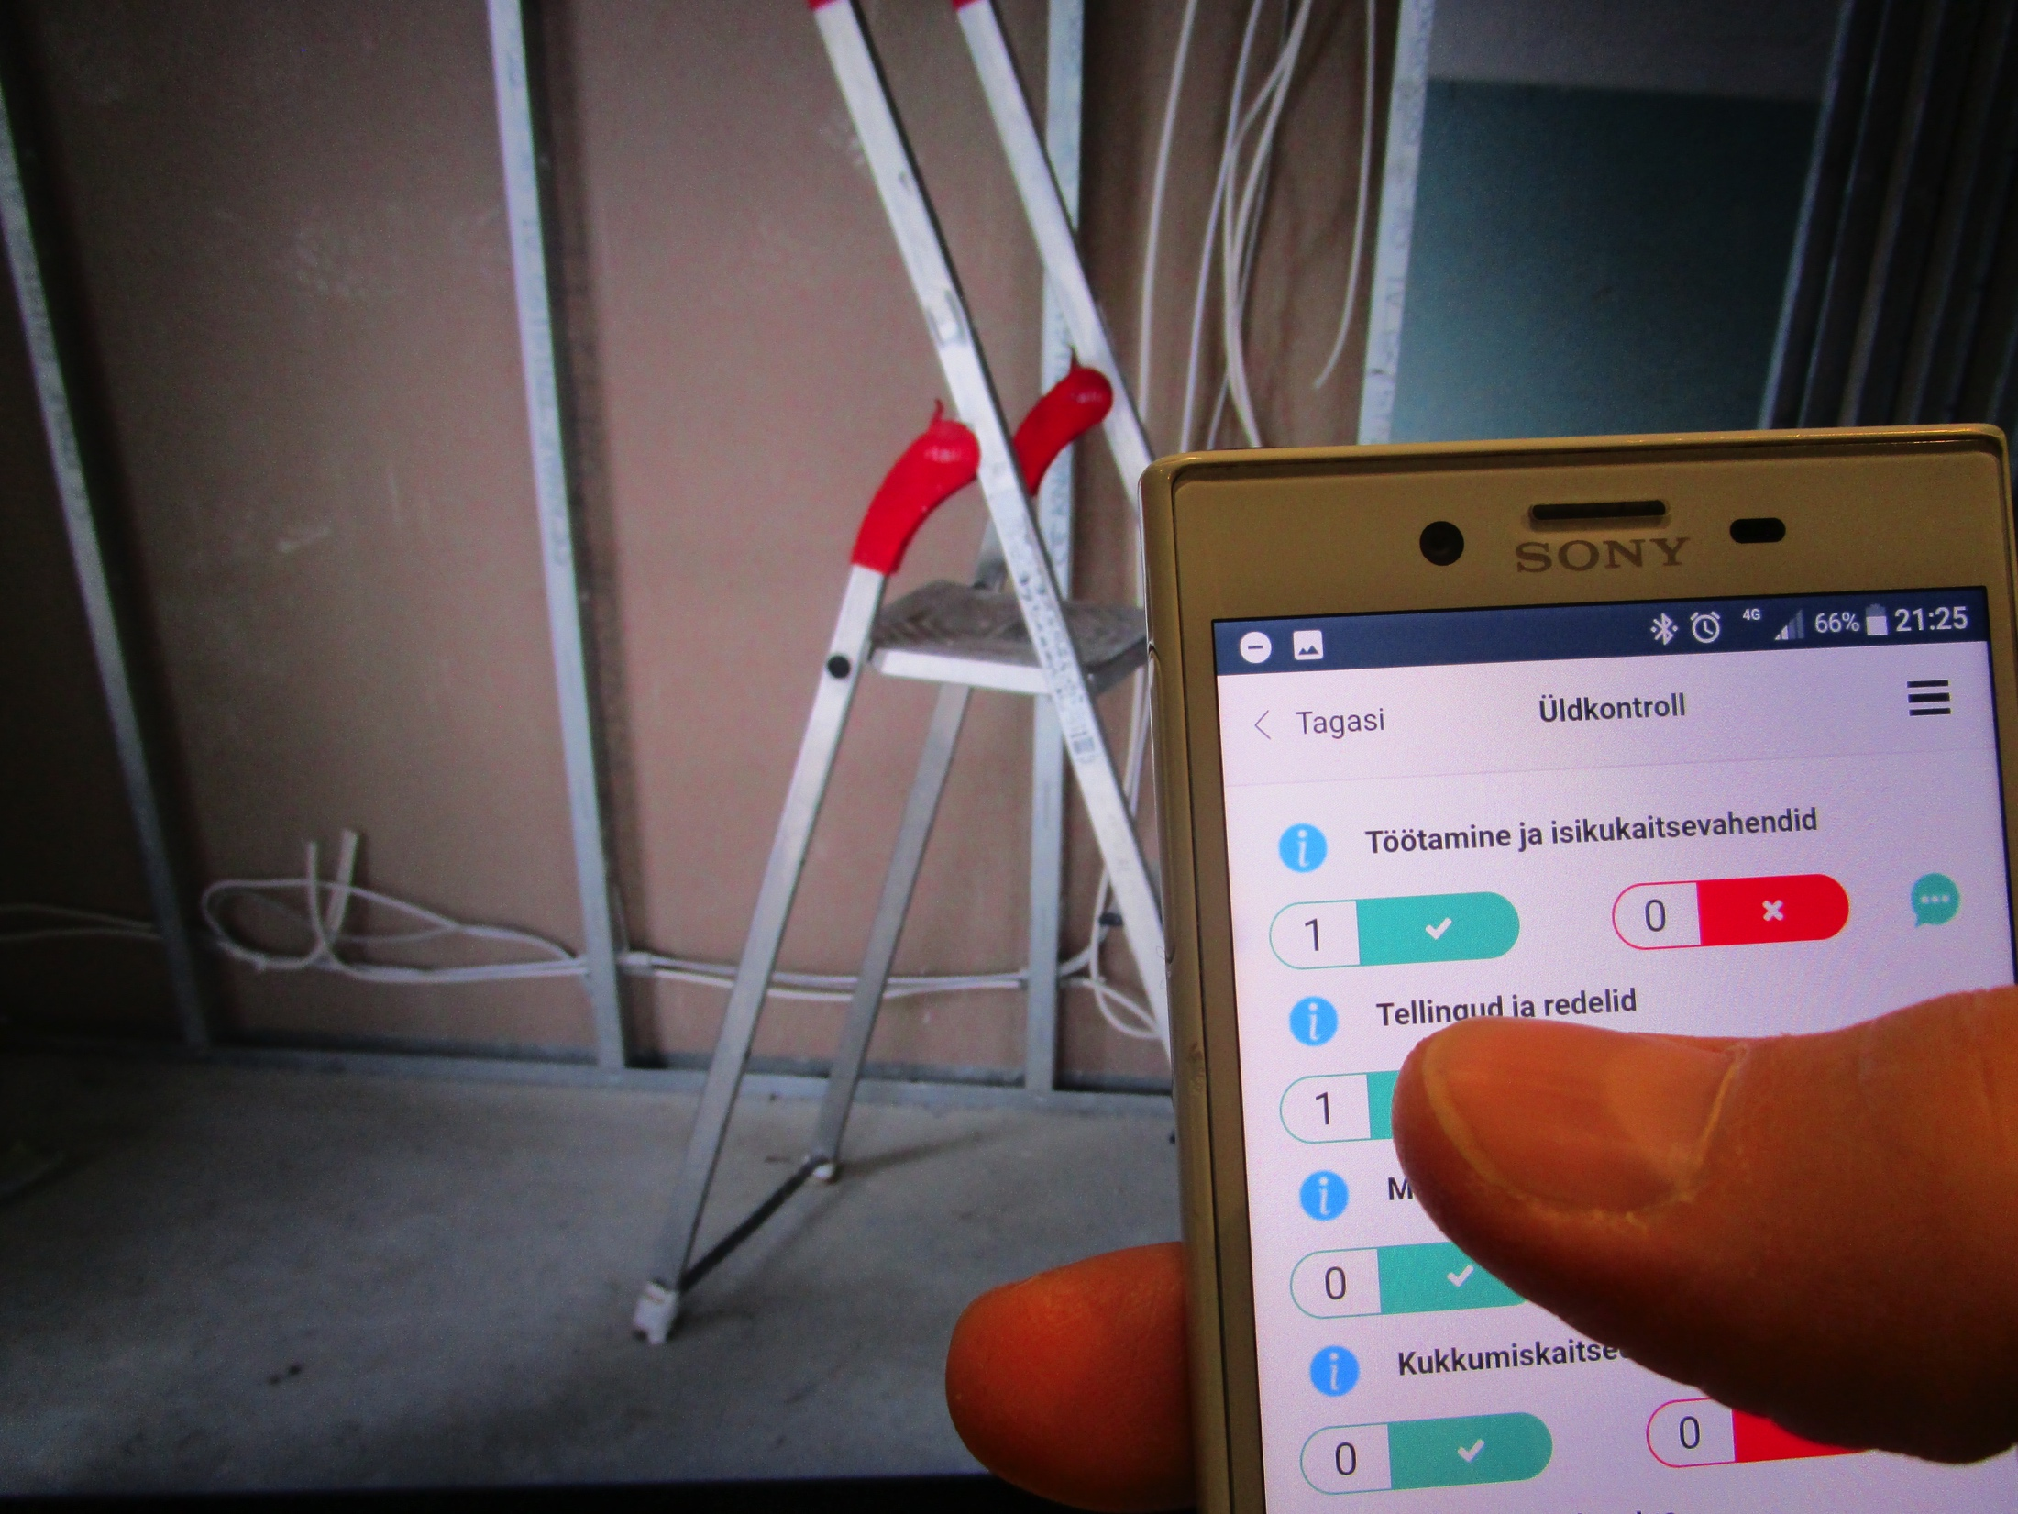
signs observations -
is it ok (meets the requirements)
or
not in order
(does not meet the requirements)

Slide 13
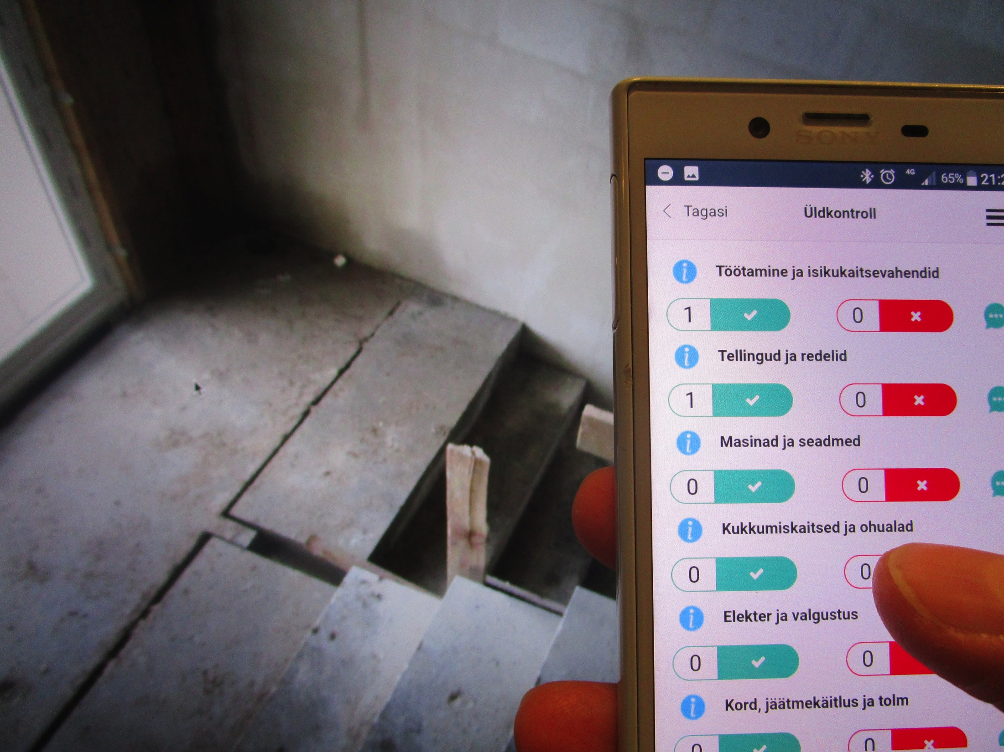
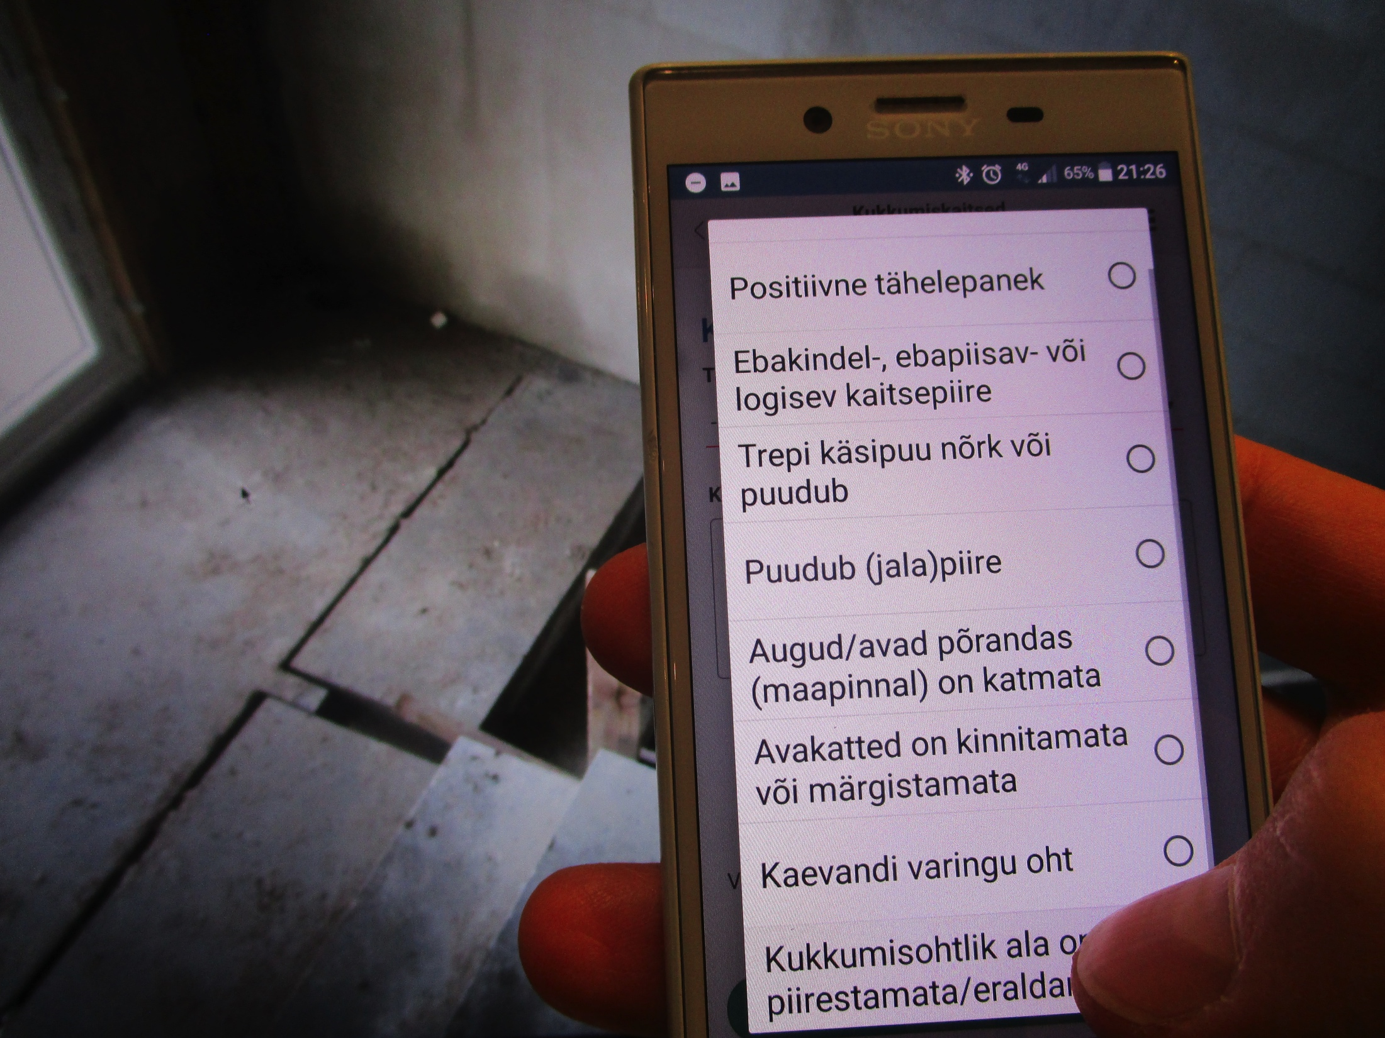
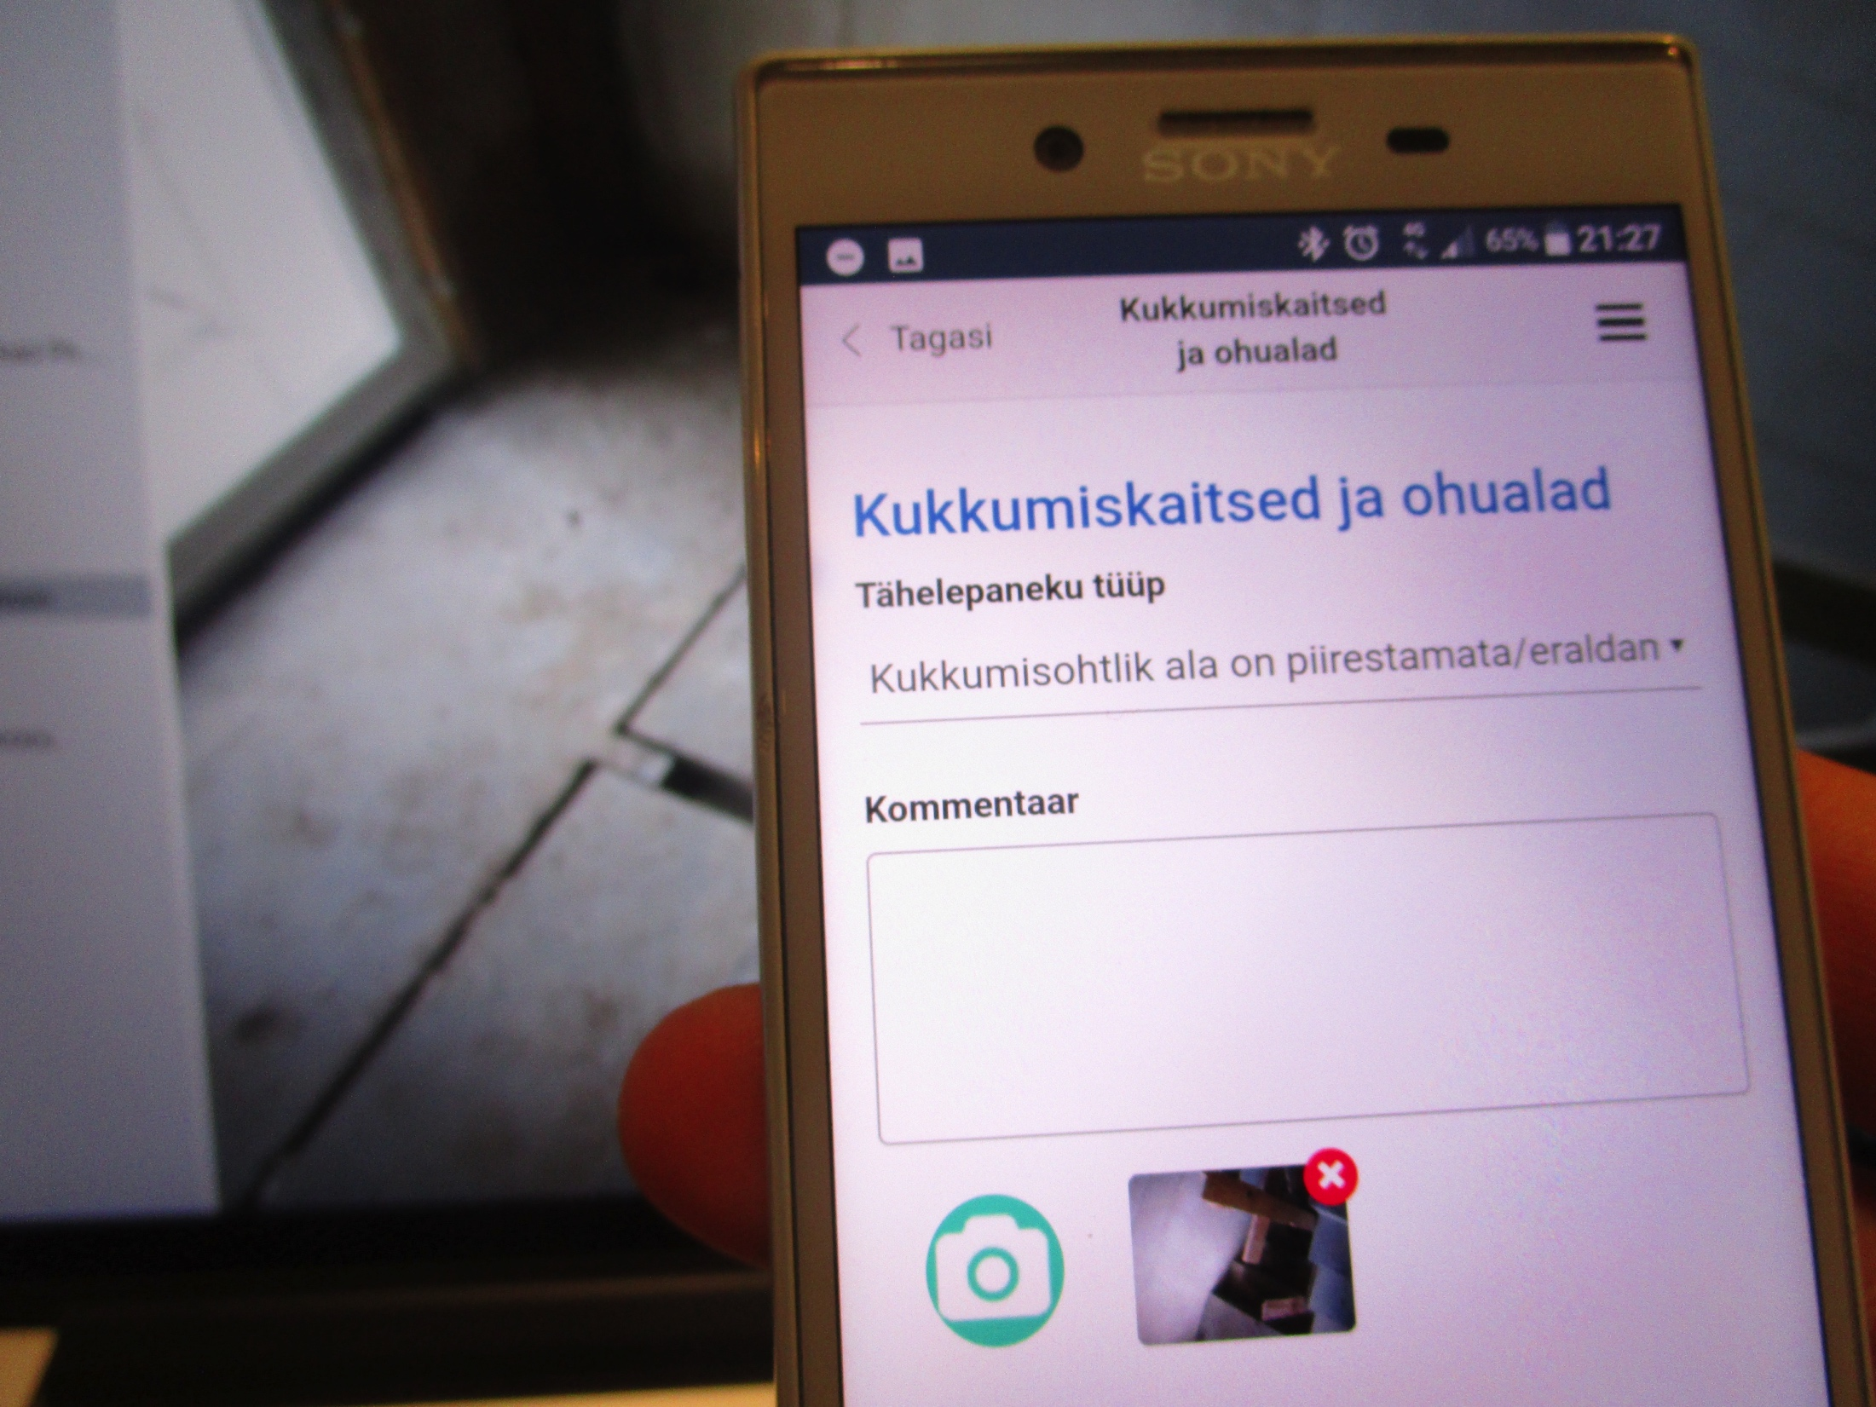
attach to the observation a predefined explanation and, if necessary, a comment and a photograph, the person responsible and the deadline for elimination of the error

Slide 14
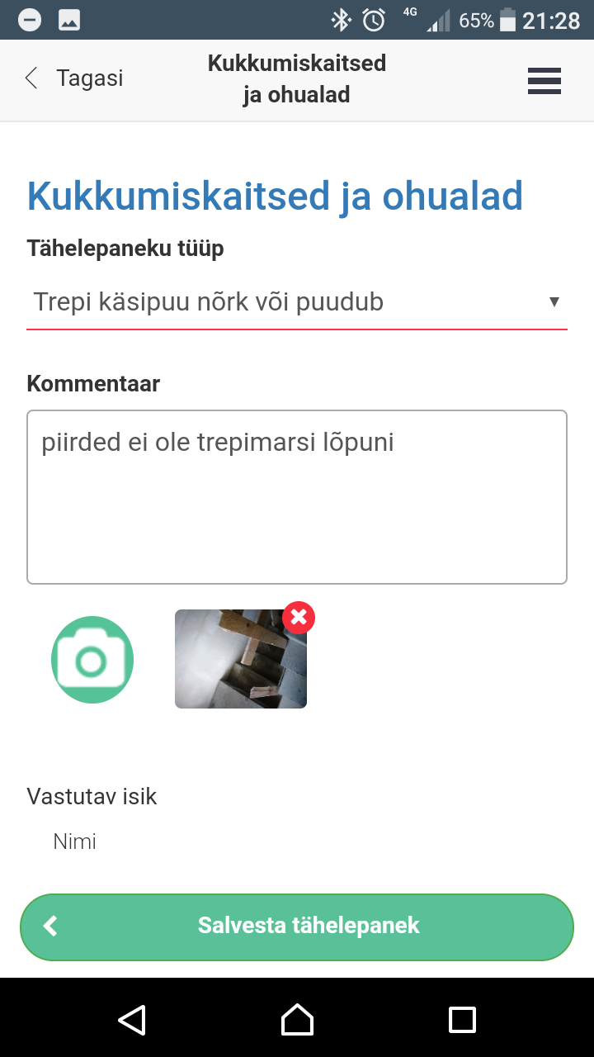
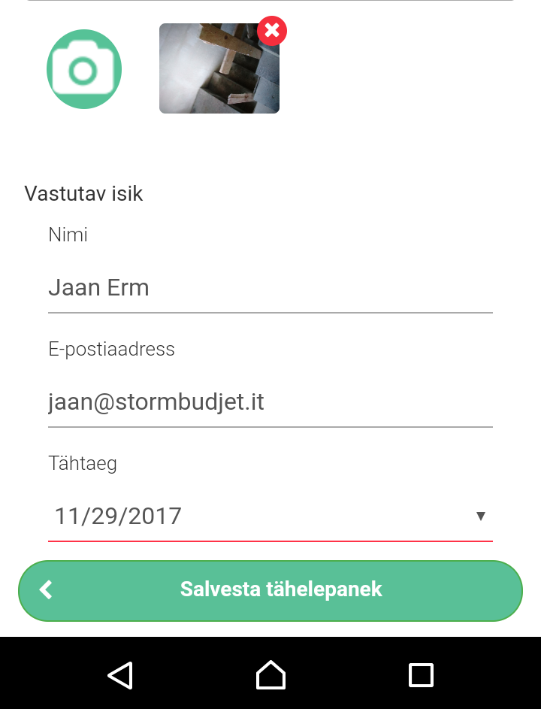
When the site tour / the inspection is completed, click on the finish button and a report of the findings will be automatically generated and sent to your e-mail address and a list of deficiencies to the e-mail (s) of the responsible managers.

Slide 15
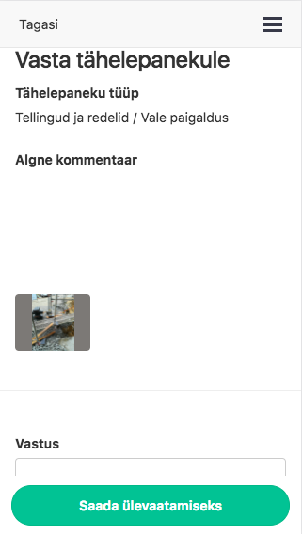
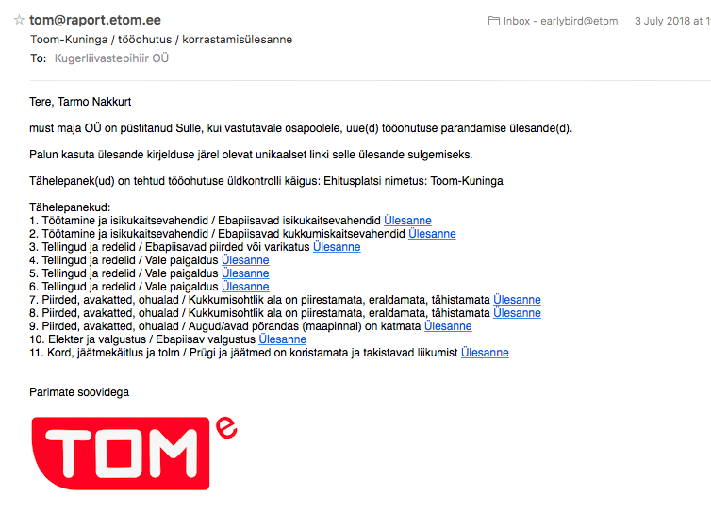

Slide 16
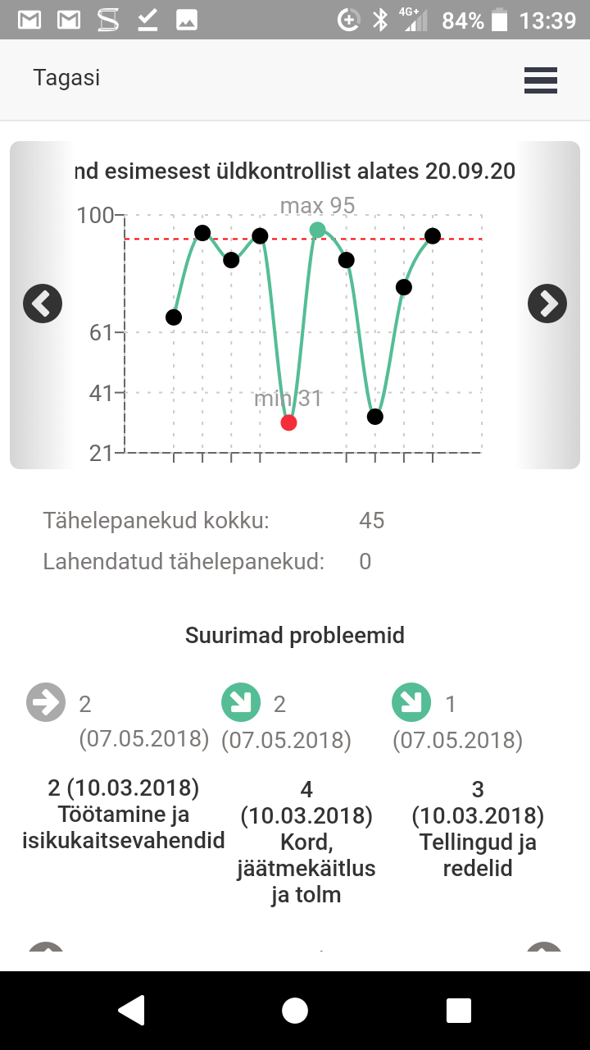
the application provides an indication of whether the occupational safety situation has improved over time or not
and displays the categories with the largest negative results

Slide 17
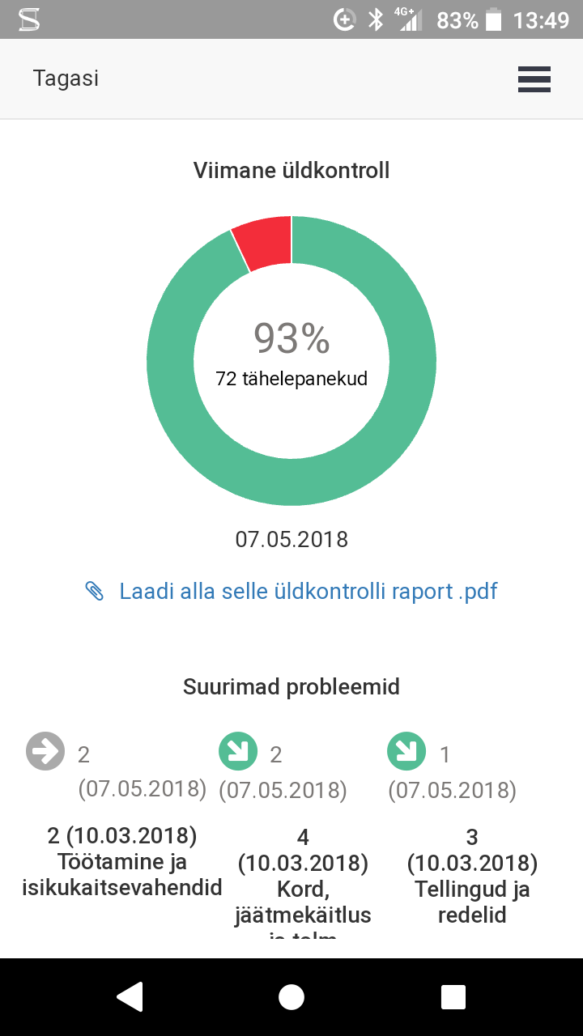
you will see the result of the last general check numerically and you will be shown the problem categories and trends
and displays the categories with the largest negative results

Slide 18
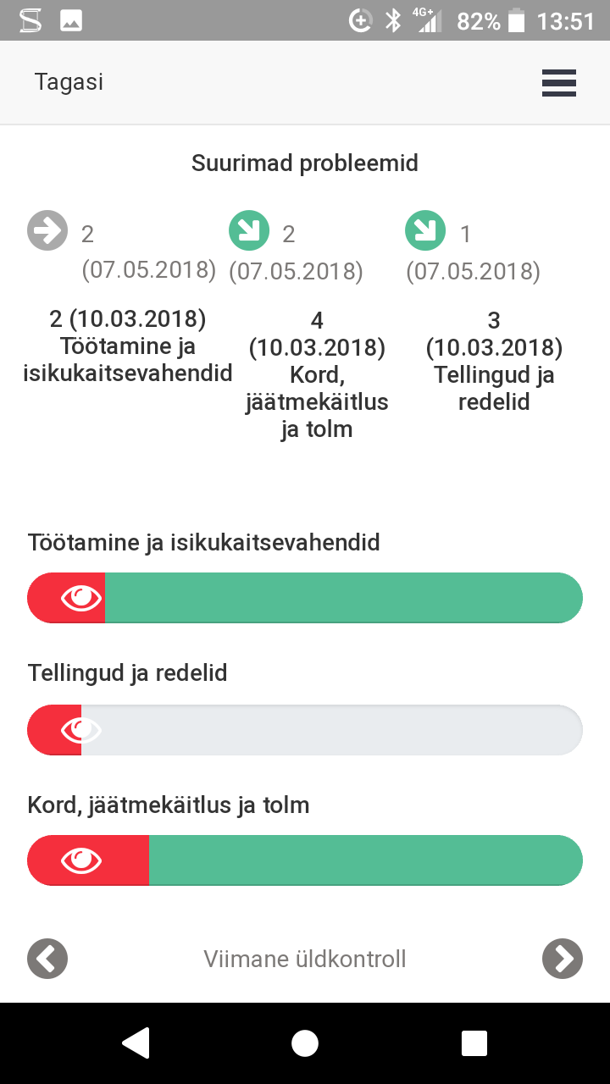
you can "disassemble" the findings of each category and see the main causes and causes (by subcategories)

Slide 19
All this and much more:
saves on the organization of general inspections and
the time taken to carry it out
gives a good overview of the situation on the square and
changes over time
always ensures correct documentation and
preservation of documents
helps to inform responsible parties quickly and
keep an eye on problems

